Slide 1
HEALHCARE CHATBOT
Group Members:
Ankit Ghosal
Ayush Raj
Sheikh Shahnawaz Hussain
Saransh Gupta

Slide 2

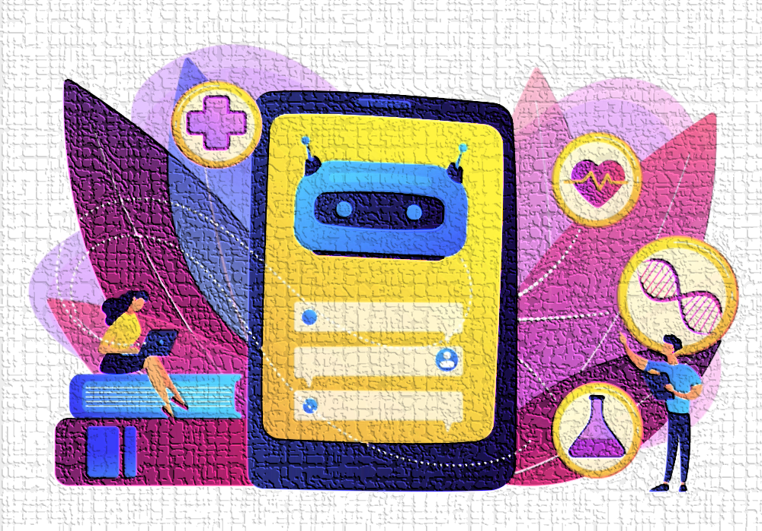
Healthcare
Chatbot

Slide 3
The Contents
01
Introduction
02
Where Healthcare chatbots can be useful
03
AI in Chatbot
04
Dataset

Slide 4

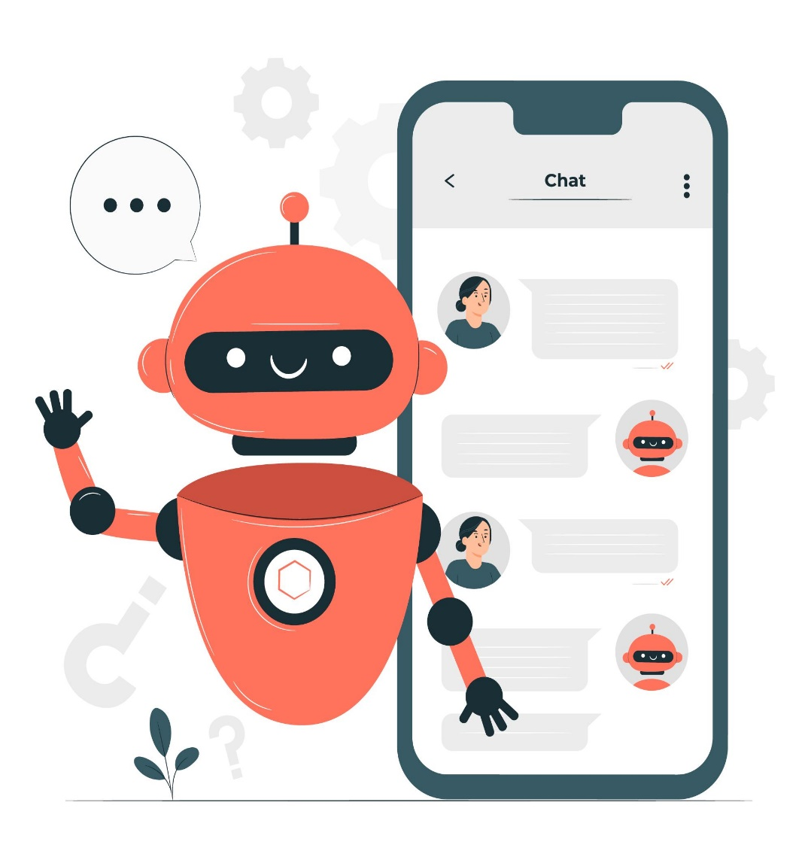
Introduction
Artificial intelligence has entered into healthcare and is making a big difference. The introduction of chatbots in the healthcare sector enables medical professionals to sail in the most demanding professionals. Chatbots are an excellent tool that offers a massive boost in multiple industries.
Similarly, they are now showing their potential in the healthcare sector.

Slide 5
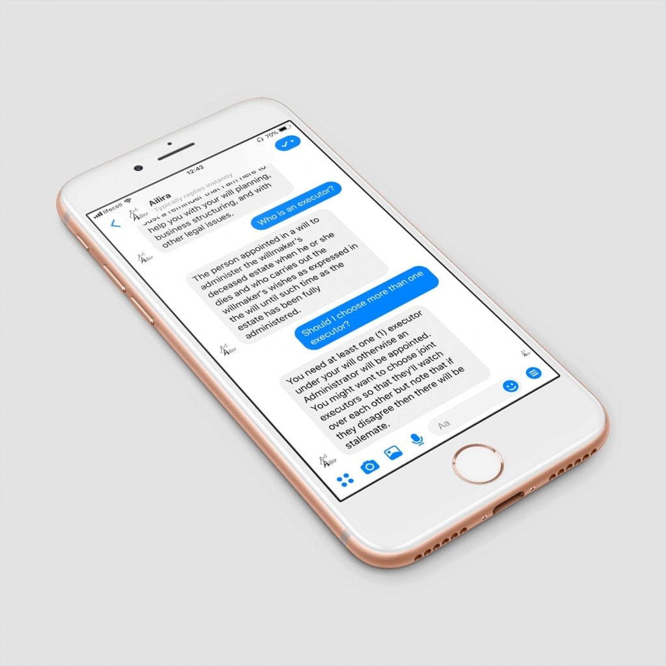

Where Healthcare Chatbots Can Be Useful
Provide Medical Information
Chatbot algorithms are trained on massive healthcare data including disease symptoms, diagnostics, markers, and available treatments. Public datasets are used to continuously train chatbots, for new disease outbreaks such as
COVID for COVID-19 diagnosis,
Etc.

Slide 6

2. Medicine Recommendation
It has a dataset of medicine which will be recommended to the user based on their queries.
Like for Ex:- If user has fever it will recommend the medicine related to fever, like paracetamol and such.

Slide 7
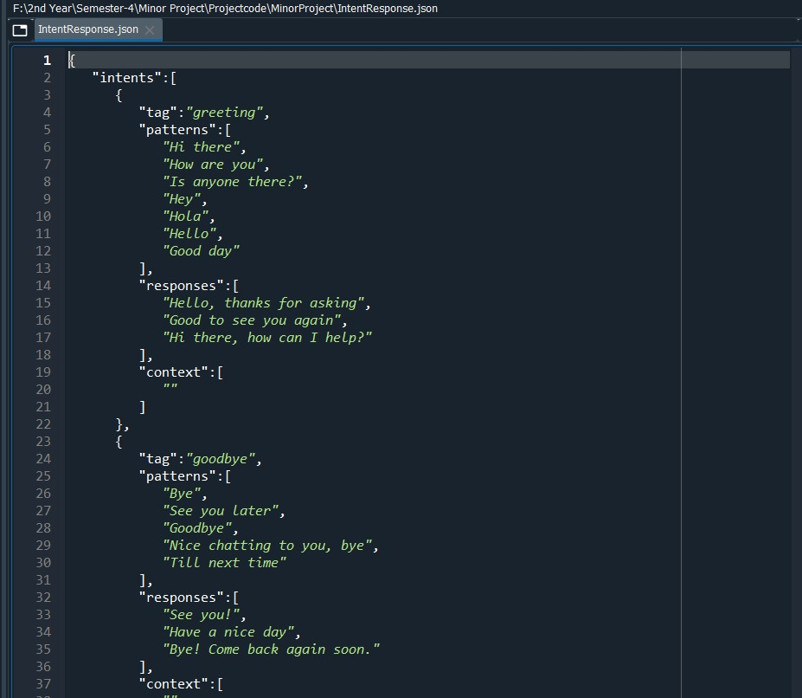
3. AI in Chatbot

Slide 8
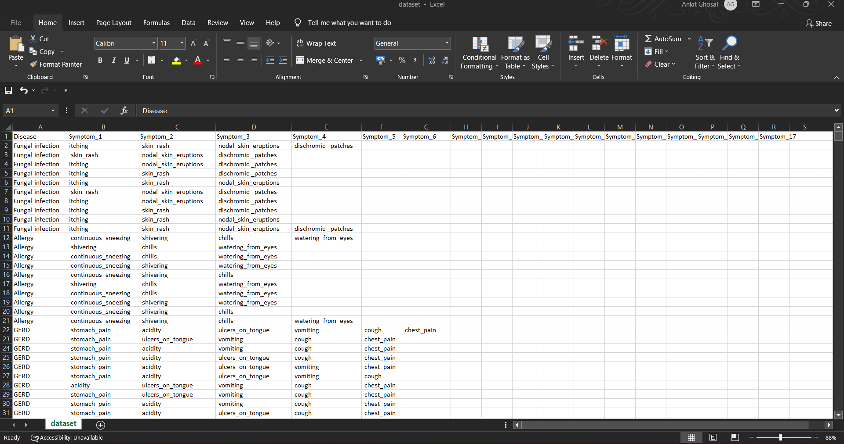
4. Dataset
Disease and symptom dataset

Slide 9
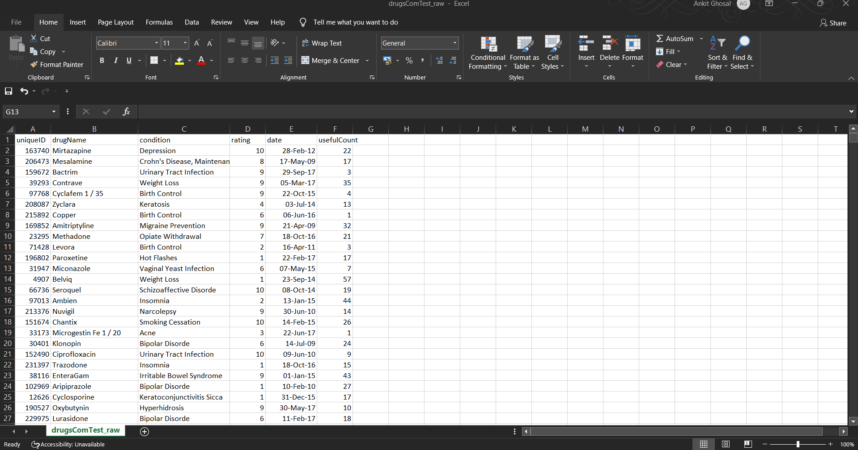
Medicines Dataset

Slide 10
5. Deployment: WhatsApp
Platform Used: We are using Twilio sandbox for WhatsApp API.
Simply and securely send WhatsApp messages with Twilio Apps. Integrate WhatsApp and other communications channels like SMS and MMS with the Programmable Messaging API, or orchestrate multichannel, multiparty interactions using the Conversations API. With built-in tools and software for visual workflows, interactive buttons, analytics, and template message management, Twilio offers more than pure connectivity.

Slide 11


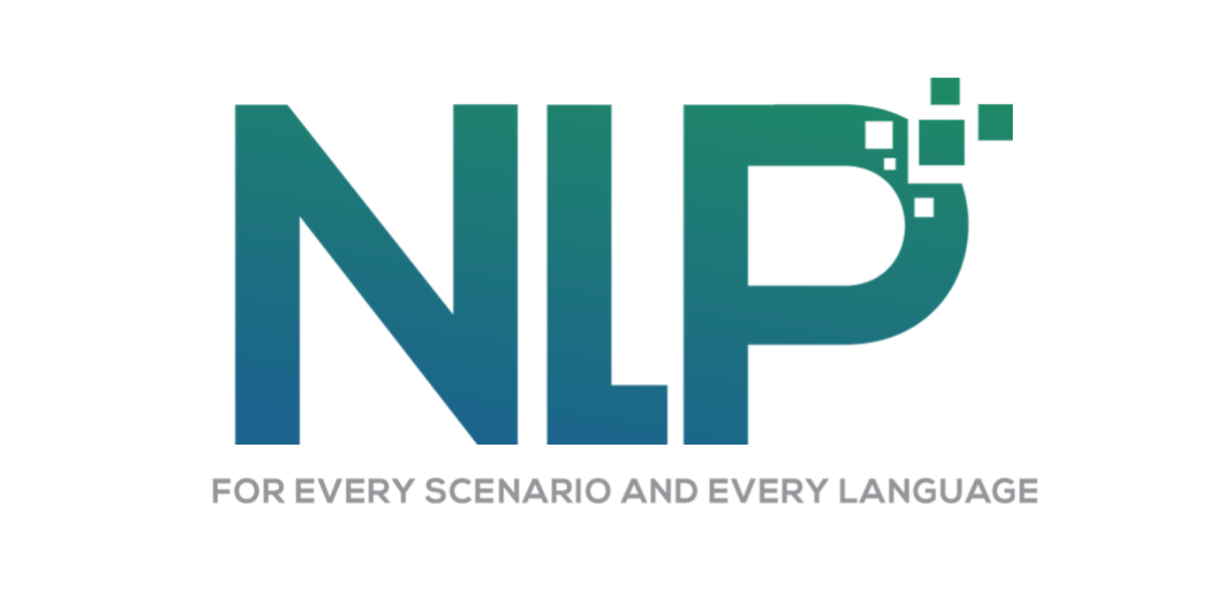


6. Platform Used
Language: Python
IDE: Spyder
Libraries: NLTK, NLP
API: Twilio
Other: ngrok

Slide 12
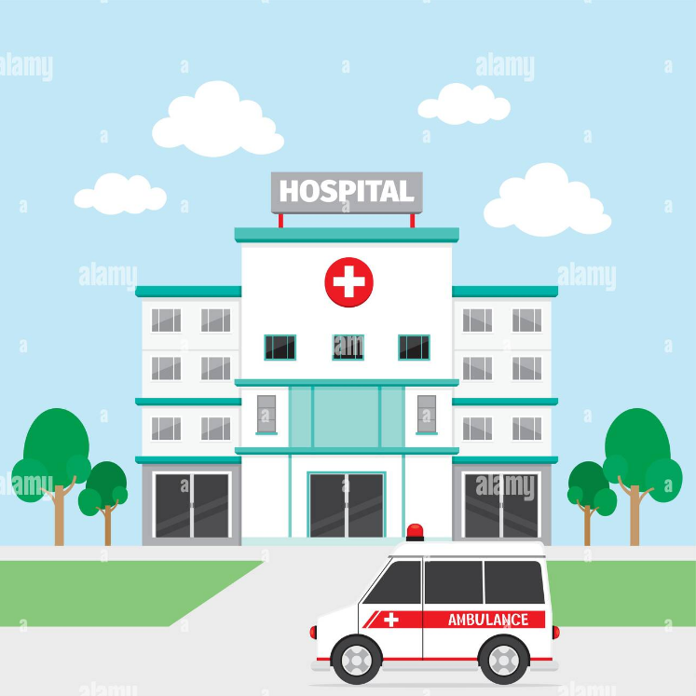
7. FUTURE SCOPE
1. Hospitals and Pharmacy
In future, we have envisioned to add a hospital and pharmacy dataset so that the chatbot will become capable of referring patients to doctors for a more comprehensive checkup.

Slide 13

2. Schedule medical appointments
Chatbots are integrated into the medical facility system to extract information about suitable physicians, available slots, and clinics and pharmacy working days.

Slide 14
8. CONTRIBUTION
Ayush: He is working on the code for the basic structure of the chatbot and AI based welcome intent response.
Ankit: He is working on the acquiring dataset and training and testing of the dataset.
Sheikh: He is working on WhatsApp API deployment.
Saransh: He is working on AI based Medical intent response.

